Slide 1


Slide 2

Training For CRO
To improve Work Activities

Slide 3
Contents
Build Wall before enemy enters
Defining CS
Role of CRO
Suzuki’s History
Pak Suzuki’s Profile
Retaining Customers
General Awareness
Service Activity Procedures (SAP)
SAP Analysis
Basic way of Thinking
Awareness with Warranty Policy & Warranty Booklet
Suzuki Vision
Market Statistics
Loyal Customer

Slide 4
Contents
FFI
Engine System
Fuel System
SFI
Schedule Maintenance
Periodic Maintenance A,B,C
Cooling System
Electrical System
Brakes
Transmission
Charging

Slide 5
Contents
Goals
Dimensions of customers service
Positive attitude
Objectives
Why should you Improve
Basic need of the customer on call
5 Dimensions
Advantages of positive attitude
Projecting positive attitude
Managing call
How to give bad news
Angry caller
Abusive caller
Handling difficult situation

Slide 6

Vision for Service
Making our customers to select SUZUKI products again in the time of next purchase through total satisfaction for all of our existing customers
Notes:
Visual perception, interpreting what is seen
Corporate: Goal or vision, a euphemism for planning in commerce and in sport
Vision statement, a corporate long-term goal

Slide 7
In Pakistan, there are only 15% of
Vehicle buyers are first time buyer.
(Expanding market is +30% first time buyer)
To grab 85% of the buyers, we need to sell again to whom already buy a car.
And customers who buy from you before,
is the easiest target to sell car again.

Slide 8
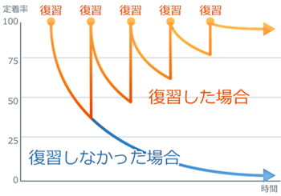
Periodic touch to the customer is keep you
as first choice of the customer
Maintain customer
Customer lost

Slide 9
1. Increase the number of free/annual/full vehicle inspection.
2. Keep vehicle condition by regular maintenance
3. Build personal relationships with customers through the increased
opportunities of meeting the customers.
4. Eliminate complaints by detecting the causes at earlier stages.
5. Higher customer loyalty.
6. Increased number of repurchase, referrals and additional purchase.
Notes:
Improving 4 KPIs (rate of initial free/annual/full vehicle inspection and number of complaints about customer service and care from customers) of the Fan-network approach will lead to the following results.
1. Periodical vehicle inspection will make the customer’s life with car better and trouble-free.
2. As a secondary benefit, it make the vehicle’s trade-in/resale value higher by maintaining good conditions.
3. Opportunities to communicate with customers will increase as their number of showroom visits for servicing increases, which also contributes to making good relationship with customers.
4. Good relationship with customers will reduce complaints or make those less-troublesome.
5. Satisfied customers will become Suzuki fans.
6. Suzuki fans give us increased profit opportunities such as repurchasing, referrals and additional purchases.

Slide 10
How to Recognize Loyal Customer?

Slide 11
Ｓ
Ａ
Ｂ
Ｃ
Ｄ
★★★★
★★★
Bringing customers to higher rank
★★
★
Notes:
If we could create showrooms which make customers happy/satisfied by the Fan-network Declaration activities, we can expect an increase in loyal customers (Suzuki fans) who will bring us more profit opportunities such as servicing, repurchasing and referral.

Slide 12
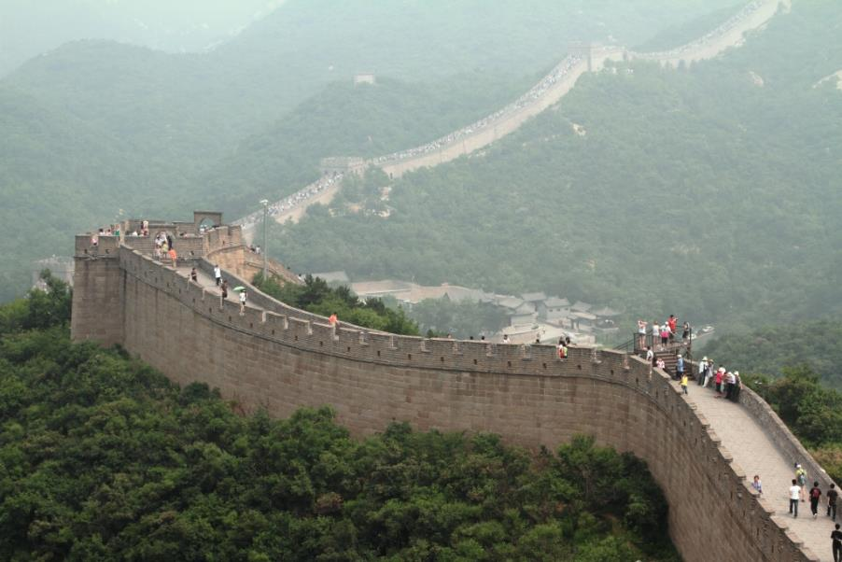
To prevent the strong enemy enter to our land,
we have to build up strong wall in advance
Built the wall after enemy entered is
no meaning, so we need prepare now.

Slide 13
Suzuki’s History

Slide 14
MILESTONES
1975 Naya Daur Motors was appointed as Suzuki Automobile distributors.
1983 Joint venture agreement was signed between SMC and Govt. of Pakistan.
1983 Pak Suzuki Motor Company was registered.
1992 Management was taken over by Suzuki Motor Corporation.
1996 Suzuki Motor Corporation increased its share to 72.8%
1997 Roll out of 100,000th units for Bin Qasim

Slide 15
MILESTONES
2000 Production of factory fitted CNG vehicles started.
2003 Pak Suzuki celebrated “20 Years” of operations in Pakistan.
2003 Pak Suzuki achieved total sales of above 600,000 since inception
2005 Production capacity expansion up to 80,000 vehicles per year completed.
2006 Production capacity was further enhanced to 120,000 vehicles per year.

Slide 16
MILESTONES
2006 Pak Suzuki achieved total sales of above 100,000 in the same year.
2007 Production capacity was further enhanced to 150,000 vehicles per year.
2008 Pak Suzuki completed “25 Years” of production
2009 1 million^{th} Vehicle produced. Prime Minister of Pakistan inaugurated the ceremony.
2010 1300cc Suzuki Swift DLX version car introduced.
2010 750,000th 800cc vehicle rolls out.

Slide 17
MILESTONES
2010 500,000th CNG vehicle production milestone achieved.
2010 800cc Cargo Van launched.
2011 1300cc Suzuki Swift DX version car introduced.
2012 1st July 2012 all vehicles assembled in Pak Suzuki are EURO-II

Slide 18
Model Codes
MEHRAN SB308
BOLAN ST308VTR
RAVI ST308R
ALTO RA410
CULTUS SF310/410
LIANA RH413/416(EMINENT)
SWIFT RS413
JIMNY SN413
APV GC415
GRAND VITARA(XL7) JA627
WAGON R A1J310
KIZASHI A6B424

Slide 19
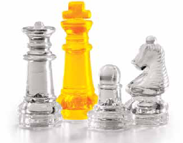
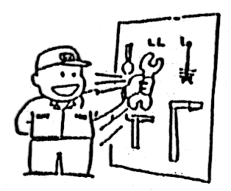
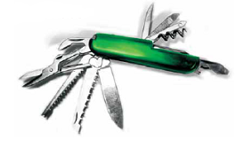
The Business
MARKETING :
TO GET THE BUSINESS
CUSTOMER CARE :
TO KEEP THE BUSINESS
MANAGEMENT :
TO GET PROFIT FROM THE BUSINESS

Slide 20
Retaining Customers
What will increase
Service Turnover?
Spare Parts Sales?
Vehicle Sales?
The answer is;
“Customer Satisfaction”

Slide 21

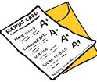
Defining CS
Customer satisfaction, a business term, is a measure of how products and services supplied by a company meet or surpass customer expectation.

Slide 22

CUSTOMER’S MINDSET
1. SATISFIED
Provided Appropriate Services
Collect Customer Loyalty
Good word of mouth among friends/family
Positive reflection of Corporate Image
Increase in Customer Retention
Notes:
GC

Slide 23
CUSTOMER’S MINDSET
2. NOT BAD
Services at Border-Line of Expectations
Low chances of Recommendations
Customer thinks about switching
Neutral reflection of Corporate Image
Impact on Customer Retention
Notes:
LC

Slide 24
CUSTOMER’S MINDSET
3. DISSATISFIED
Below than Customer’s expectations level
Bad word of mouth the Friends/Family
Customer will definitely switch
Negative reflection of Corporate Image
Decrease in Customer Retention
Notes:
BC

Slide 25
CS Leads to 3R
R - REVISIT (Loyalty)
R - REPURCHASE (Loyalty)
R - RECOMMENDATION (Advocacy)

Slide 26
ORGANIZATION OF WORKSHOP
 |  |  | GENERAL MANAGER
 | PARTS MANAGER |  | SERVICE MANAGER |  | CRO
 | Controls inventory level as per workshop consumption rates and counter sales; Places and follows-up of parts order. Maintains parts catalogues. Maintains close liaison with workshop. |  | Responsible for overall service operations: Administration, Profitability, 5 S, Training of staff, Warranty administration, Customer relations, Planning & supervision of service shop working. |  | Customer complaint handling; Implementation of customer care activities as per SAPs for good customer relations with close co-ordination of Service Manager and Advisors.
 | PARTS STAFF |  | SERVICE ADVISORS
 | Picking and binning of parts, Maintain 5S. Issuance of parts to service shop. |  | Attends customer, Inspects vehicle, Opens Job card, Checks history, Estimates charges for customer, Up-dates customer about job, Follow-up of Job, Explains the job to customer at the time of delivery. Implementation of SAPs
 |  |  | SUPERVISORS
 |  |  | Supervision of work in service shop & maintain 5S; Diagnosis of defect, Explain the work to be done as per job card to mechanic, Final inspection, Road test etc.
 |  |  | TECHNICIANS
 |  |  | To carry out the job as per job card & instructions of supervisor in a reasonable time on set standards & maintain 5S

Slide 27
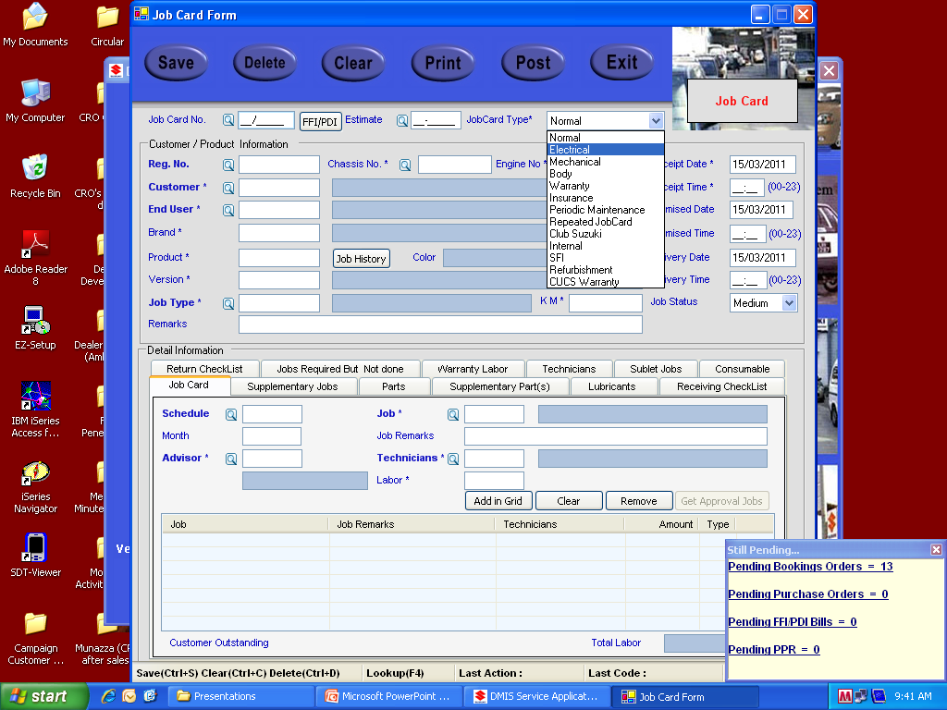
Job Cards Type
PDI JOB CARD
FFI JOB CARD
SFI JOB CARD
WARRANTY JOB CARD
MECHANICAL JOB CARD (Heavy Repairs, Normal Maintenance, Periodic Maintenance)
DENT PAINT JOB CARD

Slide 28
SERVICE ACTIVITY PROCEDURES
(SAP)

Slide 29
Responsibilities Of CRO
Main jobs in this regards are as follows.
Handling of Customer Complaints.
Handling of Service Feed Back Card & deciding counter measure along with Management.
Post Service Follow up and Analysis/Countermeasures.
Repeat job Analysis/Countermeasures and Attending the special customer's vehicle (Repeat Job), supervise the required jobs.
Care for Customers at waiting area.
Implement SAP (new vehicle delivery) in coordination with sales staff.
Timely Follow-up for Next Due Maintenance by sending follow-up letters and calls.

Slide 30
SAP Activities
Service Feedback Cards

Slide 31
Feed Back Cards
Objective: Improve overall workshop service to get total CS.
Action: To get an immediate feedback on the customer's experience at workshop.
Repeat visit for same problem. Timely delivery of vehicle. Quality of cleanliness of the car. Reasonable charges. The service advisor should hand over this feedback card to the customer. Feedback cards must be analyzed on weekly basis by CRO and submitted to Management for counter measure.
Critical activities affecting customer satisfaction

Slide 32
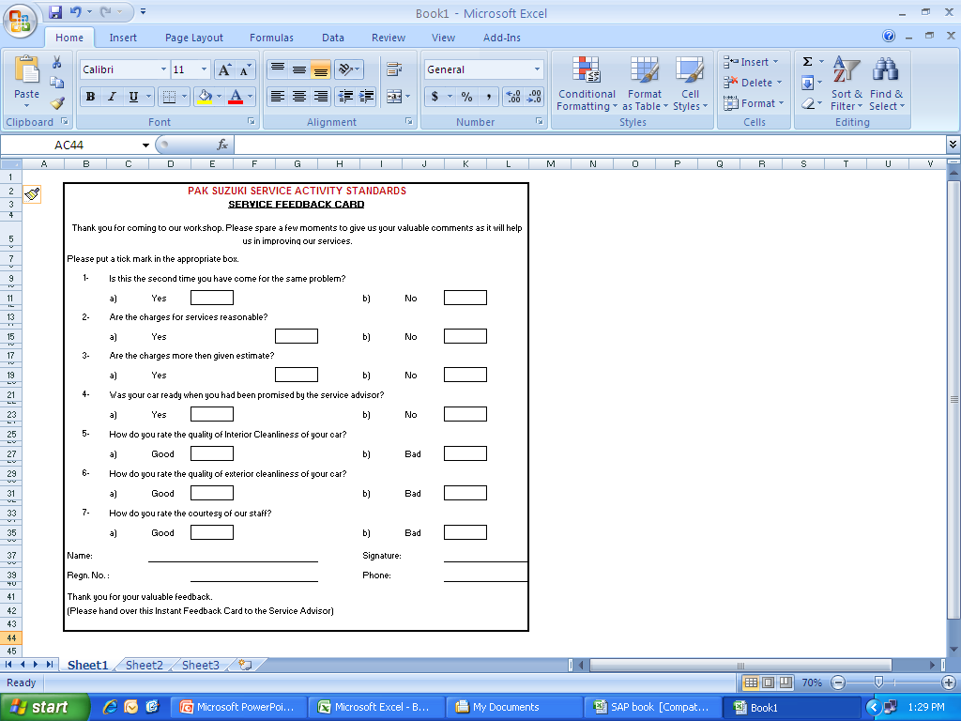
Feed Back Cards

Slide 33
Feed Back Weekly Report
06 TO 12 Feb 2013 (2nd Week)
Total customer attended | 98
Customer visited 2nd time for the same job | 5
Service charges was more than given estimate | 2
The vehicle was not ready at promised time | 4
Quality of washing of the vehicle was not satisfactory | 1
Total dissatisfied customer | 12
Percentage of dissatisfied customer | 12.24%
FORMULA: Total dissatisfied Customer * 100 = % of Dissatisfied Customer. Total Customer Attended Total attended customer
ANALYSIS:
Customer visited 2nd time due to starting problem, misfiring on CNG and CNG consumption high.
After dismantling more work turnout so, estimate also goes higher.
Quality of washing has turn much better but need more perfection.
COUNTERMEASURES:
Mechanics need more training in Tuning. (Schedule on job Training)
Service Advisors should be inform to Customer about job and estimate before delivery.
Floor In charge and Service Advisors should be follow the Time Motion Study.
Service Boys have been instructed to be more care full.

Slide 34
SAP Activities
Post Service Follow-ups

Slide 35
SAP Activities
post service followup
OBJECTIVE:
To ensure that vehicle which has been delivered to customer after service should be free of any defects and customer enjoy driving with peace of mind.
To develop a statistical base to monitor frequency of common problems related to service and service quality.
ACTION:
To Contact Customer on telephone 3-4 days after service to enquire about satisfaction with work performed.

Slide 36
SAP Activities
POST SERVICE FOLLOW-UP
S. No. | Customer Name, Address, Phone#. | Reg. No. | Model | KMS | Job Detail | Delivery Date | Follow-Up Date | Satisfied Y/N | Remarks
1 | Ahmed | AGC-234 | SY413 | 55000 |  | 10/7/2010 | 13/7/10 | Satisfied
2 | Anwar | RGD-234 | SF410 | 1000 |  | 10/7/2010 | 13/7/10 | Satisfied
3 | Azam | FDS-345 | SB308 | 5075 |  | 10/7/2010 | 13/7/10 | Satisfied
4 | Shakeel | FGT-456 | RA410 | 5000 | 5000 KM INSPECTION. | 10/7/2010 | 13/7/10 | Not Satisfied | Starting Problem on CNG and CNG Consumption High (He will come on 15 July).
5 | Afridi | CR-4567 | ST308R | 10000 |  | 10/7/2010 | 13/7/10 | Satisfied
6 | Adnan | FYR-675 | SF410 | 15125 |  | 10/7/2010 | 13/7/10 | Satisfied
7 | Shahrukh | DFF-875 | SB308 | 17500 |  | 10/7/2010 | 13/7/10 | Satisfied
8 | Salman | GRE-850 | RA410 | 21200 |  | 10/7/2010 | 13/7/10 | Satisfied
9 | Fahad | RGD-234 | RS413 | 5000 |  | 10/7/2010 | 13/7/10 | Not Contacted | Powered Off
10 | Anwar | AGD-234 | SF410 | 1000 |  | 11/7/2010 | 14/7/10 | Satisfied
11 | Ganguly | FDS-345 | RH413 | 5000 |  | 11/7/2010 | 14/7/10 | Satisfied
12 | Waseem | CN-1234 | ST308VTR | 5000 |  | 11/7/2010 | 14/7/10 | Satisfied
13 | Afridi | HEY-273 | RH413 | 10000 |  | 11/7/2010 | 14/7/10 | Satisfied
14 | Adnan | FYR-675 | SF410 | 15000 |  | 11/7/2010 | 14/7/10 | Satisfied

Slide 37
SAP Activities
 |  |  |  | ANNUXURE D
POST SERVICE FOLLOW UP WEEKLY REPORT
Report For The Week : 11 TO 16 Feb 2013
Dealer Name: ABC MOTORS
DESCRIPTION |  |  | LAST WEEK | THIS WEEK
Total No. Of Customers | A |  |  | 125
No. Contacted | B |  |  | 112
% Contact | C = (B/A * 100) |  |  | 89.60%
Satisfied | D |  |  | 104
% Satisfied | E = (D/B * 100) |  |  | 92.85%
Dissatisfied | F=B-D |  |  | 8
% Dissatisfied | G=(F/B * 100) |  |  | 7.14%
Dissatisfied Attended | H |  |  | 5
% Attended | I=(H/F*100) |  |  | 62.50%
Dissatisfied Pending | J=F-H |  |  | 3
% Pending | K= (J/F * 100) |  |  | 37.50%

Slide 38
POST SERVICE FOLLOW UP WEEKLY REPORT
Report For The Week : 15th ~ 20th Apr, 2013
Dealer Name: ABC Motors
DESCRIPTION | LAST WEEK | THIS WEEK
Total No. Of Customers | 360 | 435
No. Contacted | 320 | 418
% Contact | 88.89% | 96%
Satisfied | 304 | 410
% Satisfied | 95.00% | 98%
Dissatisfied | 16 | 8
% Dissatisfied | 5% | 2%
Dissatisfied Attended | 13 | 7.36
% Attended | 81.25% | 92%
Dissatisfied Pending | 3 | 1
% Pending | 18.75% | 8%

Slide 39

What Makes Suzuki Customer to Revisit?
Product | People | Process | Price | Others | Numbers | Loyalty Factors
 |  |  |  |  | 1 | They treat me Like I am valued
 |  |  |  |  | 2 | I go there and I get the same treatment all the time
 |  |  |  |  | 3 | My car get fixed right at the fist time
 |  |  |  |  | 4 | He help me as I want
 |  |  |  |  | 5 | They are honest and loyal to me
 |  |  |  |  | 6 | I get the required stuff what I want
 |  |  |  |  | 7 | This store keep quality stuff
 |  |  |  |  | 8 | The price is right
 |  |  |  |  | 9 | When I get my cloths back they look like new
 |  |  |  |  | 10 | They always smile whenever I go there
Please check mark the box
Notes:
3THEY 2I

Slide 40
Service Department Products
Maintenance Schedule
Monthly specials (If any)
Maintenance Packages
Labor Hours
Service Advisor’s Effort
Schedule Maintenance Required Parts
Body Repair work & Parts
Notes:
3M 2S LB

Slide 41
What Do Customer Expect When They Come Into Your Parts Or Service Department ?
Expectation | People | Process | Product | Price
They hope to meet the same person
They expect to get well respected
They expect to get charged correctly
Their cars should be Fixed Right
Their cars should be Deliver on time
Their cars should be very clean
They just want quality work
Please check mark the box
Notes:
4THEY 3THEIR

Slide 42
Objections To Overcome
The price is too high.
I do not have time.
I will think about it to get it done.
My mechanic will do the same work at a very low price.
I do not have money now I will get it done in next month.
My car is too old to spend that kind of money.
I need my car latest by 2 pm and work will take more then the time I have.

Slide 43
HOW TO DEFUSE, DISARM & DEFLECT VERBAL CONFLICT
When people complaint, don’t explain; take the AAA train:
Agree
Apologize
Act

Slide 44
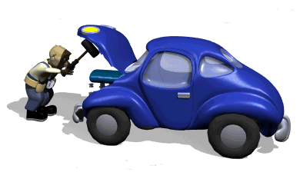
SAP Activities
Repeat Job cards

Slide 45
Repeat Job Handling
Any vehicle which is reported with the same problem within 1000 km or 20 days of the last visit (which ever comes first) should be considered as Repeat Job.
OBJECTIVE:
To ensure the customer satisfaction with our product and services by correctly identifying all Repeat jobs, giving them top Priority in workshop and taking countermeasures for improvement.

Slide 46
SAP Activities
 |  |  |  |  |  |  | Annexure A
PAK SUZUKI SERVICE ACTIVITY PROCEDURES
CASE HISTORY OF REVISIT / REPEAT JOBS
Customer's Name | Dr. Shafiq ur Rehamn |  |  | Vehicle Regn. No. |  | ACK-778
Telephone No. | 1234567 |  |  | Mobile No. | 0300-1234567
Date of Delivery | 19/02/2013 | Model | SB308 | Chassis No. | 125454 | Engine No. | B457847
Previous Job Detail | Job Demanded |  |  | Action Taken
KM: 9890 | 1. 10000 KM INSPECTION. |  |  | 1. ELECTRICAL / MECHANICAL CHECK UP
PSF Date: 20-8-2010 | 2. |  |  | 2. ENGINE TUNE UP
Status: | 3. |  |  | 3.
(I) Satisfied | 4. |  |  | 4.
(ii)Not satisfied √
Current Job Detail | Job Demanded |  |  | Action Taken |  |  | Repeat
KM: 10120 | 1. MISFIRING |  |  | 1. TAPPIT ADJUST
PSF Date: 28-8-2010 | 2. DOOR GLASS HARD |  |  | 2. LUBRICATTE
Status: | 3. |  |  | 3.
(I) Satisfied √ | 4. |  |  | 4.
(ii)Not satisfied
ANALYSIS
AFTER RE ADJUSTMENT OF TAPPIT AND LUBRICATION OF DOOR GLASS VEHICLE IS FINE.
Reasons For Generation of Revisit / Repeat Job
1. Product Quality
2. Poor Diagnosis by Supervisor.
3. Road test not done.
4. Poor workmanship in last visit. |  |  |  |  | √
5. Spare parts not available.
6. Casual attitude of mechanic / Supervisor.
7. Poor response /postponing repair by workshop
8. Not adhering to warranty policy.
9. Misbehavior during previous visit.
10. Poor PDI by the PDI staff.
11. Request for replacing parts under warranty / refund.
12. Clarification / queries / feedback / suggestions
13. Customer Education.
Sign of supervisor: |  |  |  | Sign of Service Manager:

Slide 47
SAP Activities
 |  |  |  | Annexure B
PAK SUZUKI SERVICE ACTIVITY PROCEDURES
REPEAT JOBS COUNTER MEASURES
Tick the applicable reasons
Veh. Regn. No.: |  | ACK-778 | Present Job Card No. & Date: 25/8/2010 | 29765
Previous Job Card No. & Date: |  | 18/02/2013 29615 | Mech/Supervisor who attended previously: | MR. NOMAN
Service Advisor who attended previously: |  | MR. AHMED
Sr. No. | Reason / Analysis |  | Likely Countermeasure
1 | Product Quality was not good. | YES NO | Feedback to be given to the PSMCL After Sales Department.
 |  |  | FTR No.
 | Component Name:
 | Make:
 | Batch Code:
2 | During previous visit the defect was not diagnosed properly. | YES NO | 1- Education and training of Supervisor/ Mechanic to be done. 2- They should be sent for diagnostic skill training course, if require.
3 | Road test was not conducted. | YES NO | Road test should be ensured for such problem
4 | Poor workmanship during previous repair/ service-Mechanic does not know the correct procedure for doing the job. | NO | 1- Mechanic to be trained in workshop. 2- He should be sent for training at PSMCL. 3- Supervisor make sure that mechanic understand his instructions completely.
5 | Defect did not attended due to unavailability of required part. (a) Was the order been placed. (b) Was customer been informed after receiving the part? | YES NO | 1- If no, proper system of ordering should be made. 2- If no, then system of informing customer should be made.
 |  | YES NO
6 | Mechanic did not do the job properly due to negligence. | YES NO | 1- Education of Supervisor / Mechanic to be done. 2- Final inspection to be strengthened.
7 | Poor response / postponing repair by the workshop. | YES NO | 1- Education of Service advisor / Supervisor to change of attitude.
8 | Not adhering of Warranty Policy. | YES NO | 1- Counseling of Mechanic / Supervisor.
9 | Misbehavior during previous visit. | YES NO | 1- Education of concern staff.
10 | Poor PDI done by PDI staff. | YES NO | Strengthen PDI.
11 | Customer's request for replacing parts under warranty / refund. | YES NO | 1- Decision of warranty replacement to be taken at first instant by the Service Advisor / Service Manager.
12 | Clarification / Queries / Feedback / Suggestions. | YES NO
13 | Customer Education. | YES NO
14 | Any Other
 |  |  | Customer Relation Officer

Slide 48
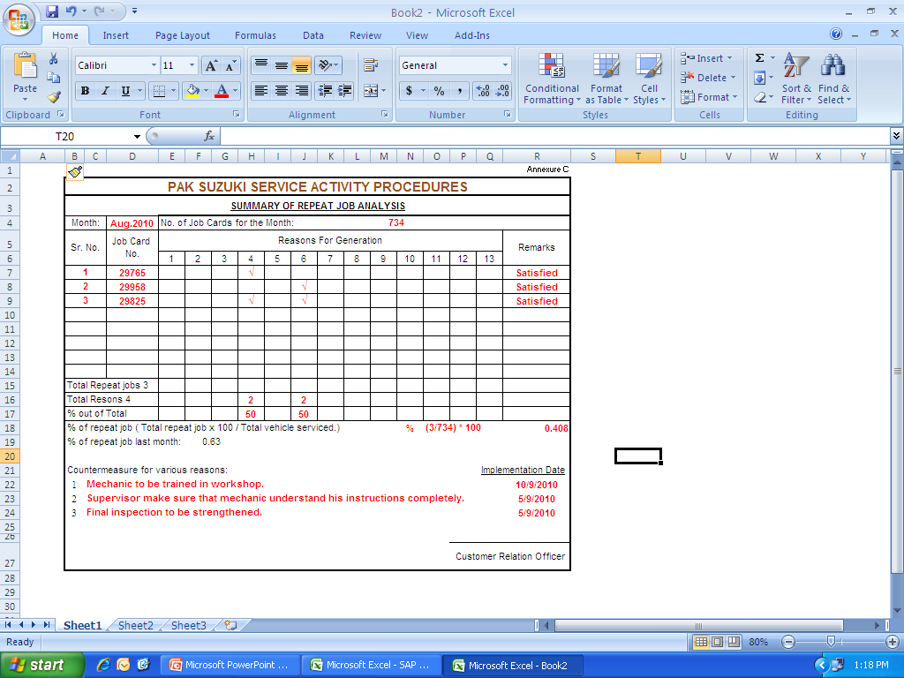
SAP Activities
Feb 13

Slide 49
Repeat Job Analysis
COMPARISON OF REPEAT JOB ANALYSIS KARACHI REGION
July to December 2013
 |  |  | Dated:31-01-2014
Nos. of Repeat Job (Reasons) |  | Jul to Sep 2013 | Oct to Dec 2013 | Comparison
 |  | 326 | 315 | -11
Reasons For Generation of Repeat Job |  | Jul to Sep 2013 | Oct to Dec 2013 | Comparison
1 | Poor workmanship in last visit. | 38.03% | 34.28% | -3.75%
2 | Poor Diagnosis by Supervisor. | 7.66% | 14.92% | 7.26%
3 | Road test not done. | 19.01% | 14.92% | -4.09%
4 | Customer Education. | 19.63% | 13.33% | -6.30%
5 | Clarification / queries / feedback / suggestions | 3.98% | 9.84% | 5.86%
6 | Casual attitude of mechanic / supervisor. | 6.13% | 7.30% | 1.17%
7 | Poor response / postponing repair by workshop | 0.30% | 2.53% | 2.23%
8 | Product Quality | 3.37% | 0.95% | -2.42%
9 | Request for replacing parts under warranty / refund. | 0.61% | 0.95% | 0.34%
10 | Misbehavior during previous visit. | 0.30% | 0.63% | 0.33%
11 | Spare parts not available. | 0.61% | 0.31% | -0.30%
12 | Not adhering to warranty policy. | 0.30% | 0.00% | -0.30%
13 | Poor PDI by the PDI staff. | 0.00% | 0.00% | 0.00%

Slide 50
Minimizing Repeat Job
Key Points:
Ensure that vehicle should be delivered to customer; free from any defect.
Perform standardized final inspection of all vehicle(s) before delivery.
Analyze and take concrete countermeasures to Remove Repeat Jobs.
In house training of workshop and office staff should be conducted on regular basis.

Slide 51
SAP Activities
Next Due Reminders

Slide 52
Why This Activity is Carried Out?
OBJECTIVE:
To increase Customer Retention and Customer Satisfaction by ensuring that due service is done at the right time through personal contact to remind them of periodic maintenance schedule of their vehicles.
To increase customer retention and CS by ensuring that due service is done at the right time through personal contact & remind them of periodic maintenance schedule of their vehicles.

Slide 53
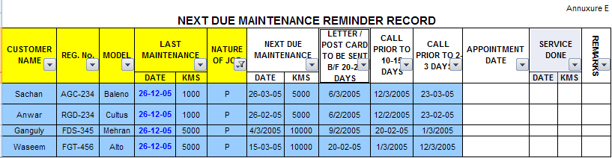
SAP Activities

Slide 54
Summary of Service Reminder
SAP Activities
 |  |  |  |  | Annexure F
No. of letters or post cards sent prior to 20-25 days |  | Total No. of customers contacted prior to 10-15 days |  | Total No. of customers contacted prior to 2-3 days |  | Total
1000 km | More than 1000 km | 1000 km | More than 1000 km | 1000 km | More than 1000 km
200 | 300 | 200 | 600 | 220 | 530 | Total Letters 500 Total Calls 1550

Slide 55

SAP Activities
Timely Delivery After Service

Slide 56
Timely Delivery
Objective: To ensure delivery of vehicle at promised time.
Introduction of Time Control Tag Time control tags will be made of acrylic sheet normally in 2 colors White or Yellow. This tag is hung inside rear view mirror of the vehicle. To identify vehicles delayed beyond promised delivery time a red hanger should be hung for clear identification. The delivery time mentioned on the card should be 30 minutes earlier than the promised time to the customer.

Slide 57
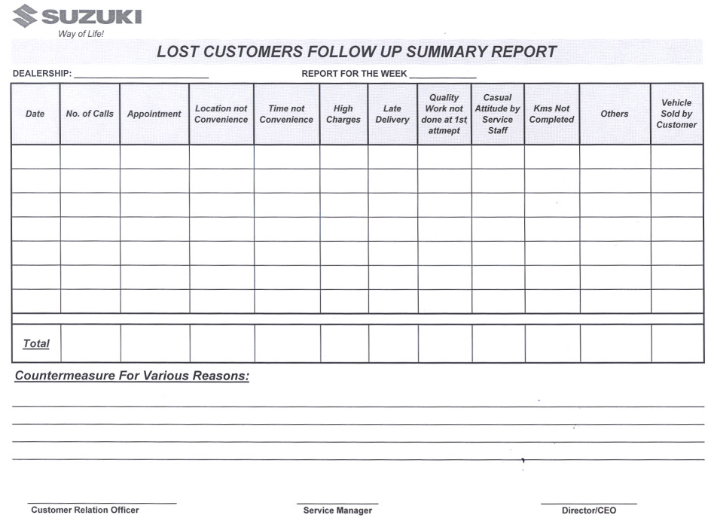

Slide 58
TECHNICAL TRAINING

Slide 59
Why FFI ? first free inspection
First chain is “Free Maintenance” at 1,000km!
Service activity means connecting the chains!
Time of Vehicle repurchase
Time of Vehicle Sales
1,000
5,000
10,000
15,000
20,000
Retention ratio keeps decreasing
Salesman
Salesman

Slide 60
What we do in FFI ?
ENGINE: Visual mechanical inspection and adjust if required.
FUEL SYSTEM: Inspection of fuel lines, hoses, connection and leakages.
ELECTRICAL: Inspection of battery electrolyte level, combination and other electrical switches.
CLUTH and TRANSMISSION: Inspection of pedals play and gear shifting adjust if required.
BRAKES: Inspect brake pedal play adjust if required.
PARKING BRAKE LEVER: Inspect lever notches adjust if required.
UNDERBODY INSPECTION: Visual inspect all under body nuts and bolts.
TEST DRIVE: Check brakes, gear shifting, speedometer, AC and all other unwanted vibration and noises.
Notes:
EFEC BPUT

Slide 61
Why SFI ? (second free inspection)
Second chain is SFI “Maintenance” at 5,000km!
Service activity means connecting the chains!
Time of Vehicle repurchase
Time of Vehicle Sales
1,000
5,000
10,000
15,000
20,000
Retention ratio keeps decreasing
Salesman
Salesman

Slide 62
What we do in SFI ?
ENGINE: Visual mechanical inspection and adjust if required. Replace engine oil and oil filter.
FUEL SYSTEM: Inspection of fuel lines, hoses, connection and leakages.
ELECTRICAL: Inspection of battery electrolyte level, combination and other electrical switches.
CLUTH and TRANSMISSION: Inspection of pedals play and gear shifting adjust if required.
BRAKES: Inspect brake pedal play adjust if required.
PARKING BRAKE LEVER: Inspect lever notches adjust if required.
UNDERBODY INSPECTION: Visual inspect all under body nuts and bolts.
TEST DRIVE: Check brakes, gear shifting, speedometer, AC and all other unwanted vibration and noises.

Slide 63
Why Schedule Maintenance ?
“Schedule Maintenance” is a connecting chain on every 5,000km!
Service activity means connecting the chains!
Time of Vehicle Sales
Time of Vehicle repurchase
1,000
5,000
10,000
15,000
20,000
25,000
Retention ratio keeps decreasing
Salesman
Salesman

Slide 64
What we do in Schedule Maintenance ?
ENGINE: Visual mechanical inspection and adjust if required. Replace engine oil and oil filter valve clearance adjustment.
FUEL SYSTEM: Inspection of fuel lines, hoses, connection and leakages.
ELECTRICAL: Inspection of battery electrolyte level, combination and other electrical switches.
CLUTH and TRANSMISSION: Replace Transmission Oil, Inspection of pedals play and gear shifting adjust if required.
BRAKES: Inspect brake pedal play adjust if required, inspect brake pads shoe replace if required.
PARKING BRAKE LEVER: Inspect lever notches adjust if required.
UNDERBODY INSPECTION: Visual inspect all under body nuts and bolts.
TEST DRIVE: Check brakes, gear shifting, speedometer, AC and any other unwanted vibration and noises.

Slide 65
Periodic Maintenance SCHEDULE (swift RS-413)
PERIODIC MAINTENANCE SCHEDULE
INTERVAL This interval should be judged by odometer reading or months, which ever comes first. Under Normal Driving Condition |  | Swift RS-413
 |  | This table includes services scheduled up to 80,000 kms. Beyond 80,000 kms, carry out the same services at the same intervals respectively.
 | km (x1,000) | 1 | 5 | 10 | 15 | 20 | 25 | 30 | 35 | 40 | 45 | 50 | 55 | 60 | 65 | 70 | 75 | 80
 | Months | 1 | 3 | 6 | 9 | 12 | 15 | 18 | 21 | 24 | 27 | 30 | 33 | 36 | 39 | 42 | 45 | 48
ENGINE
Water Pump Drive Belt & A/C V belt ( tension, wear ) |  | A | I | I | I | I | I | I | I | A | I | I | I | I | I | I | I | A
Camshaft Timing Chain |  |  |  |  |  |  |  |  |  | I |  |  |  |  |  |  |  | I
 |  | Replace @ Every 1,00,000 Kms
Valve lash ( clearance ) |  |  |  |  |  |  |  |  | I |  |  |  |  | I |  |  |  | I
Engine coolant ( level, leakage ) Suzuki Long Life coolant Standard ( Coolant Colour : Green ) |  | I | I | I | I | I | I | I | I | I | R | I | I | I | I | I | I | I
 |  | Replace @ Every 45,000 Kms
Engine cooling system hoses and connections ( leakage, damage ) |  | I | I | I | I | I | I | I | I | I&R | I | I | I | I | I | I | I | I&R
Radiator Cap Seal & Recovery valve condition ( leakage, damage ) |  | I | I | I | I | I | I | I | I | I&R | I | I | I | I | I | I | I | I&R
Thermostat Operation & Replacement |  | I | I | I | I | I | I | I | I | I | I | I | I | I | I | I | I | I
 |  | Replace at every 80,000 kms OR 48 Months
Engine Mounting ( loose and damage ) |  |  |  | T |  | T |  | T |  | T |  | T |  | T |  | T |  | T
Engine Oil filter |  | I | R | R | R | R | R | R | R | R | R | R | R | R | R | R | R | R
Engine oil |  | I | R | R | R | R | R | R | R | R | R | R | R | R | R | R | R | R
Positive Crankcase ventilation System ( hoses, connections and valve ) |  |  | I | I |  | I |  | I |  | I |  | I |  | I |  | I |  | I
Engine bolts ( All cylinder head and manifold fixing ) |  |  |  | T |  | T |  | T |  | T |  | T |  | T |  | T |  | T
Exhaust system ( noise, leakage or otherwise defective ) |  |  | I | T | I | T | I | T | I | T | I | T | I | T | I | T | I | T

Slide 66
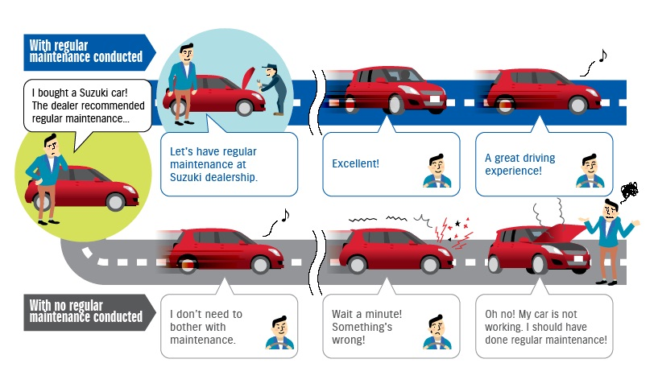

Slide 67
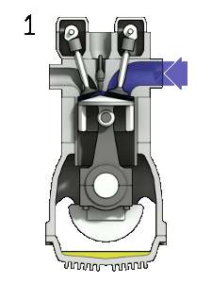
Engine
Definition…..?:-
Engine changes chemical energy of fuel into heat energy through combustion. The engine then converts this heat energy to mechanical power.

Slide 68
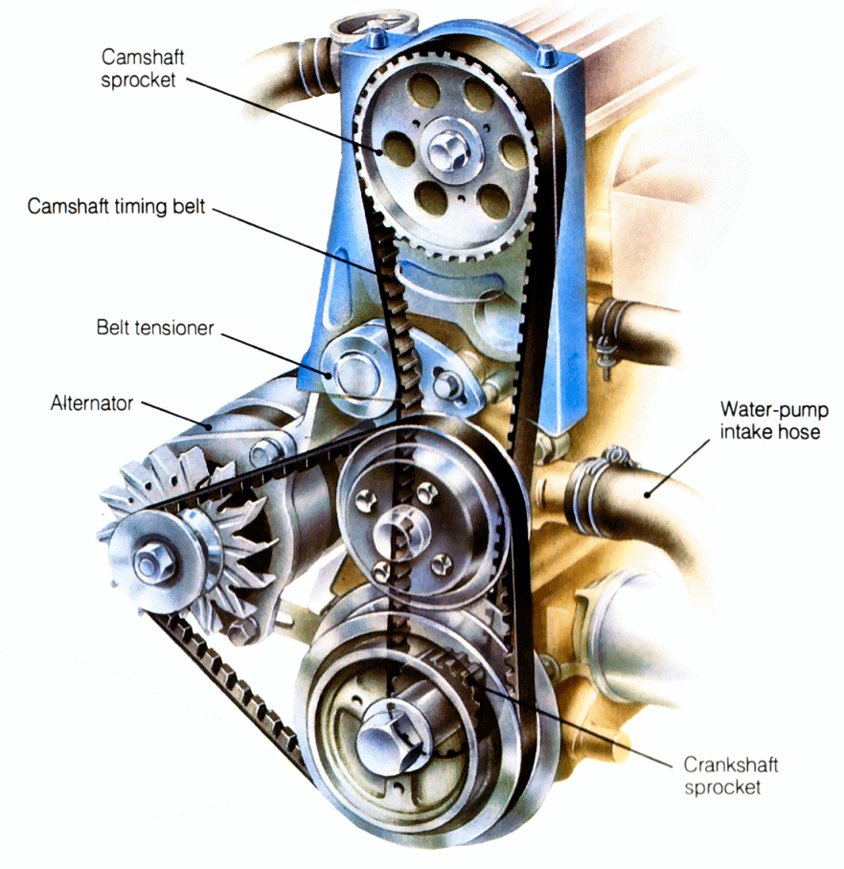
Engine
TIMING BELT
Oil Filter

Slide 69
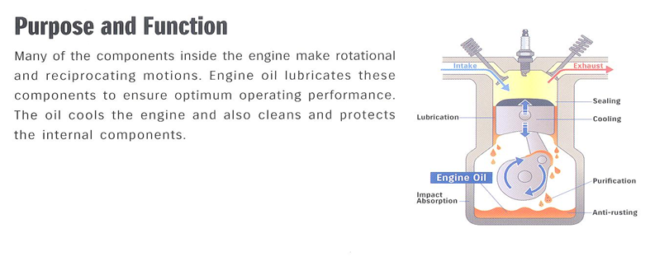
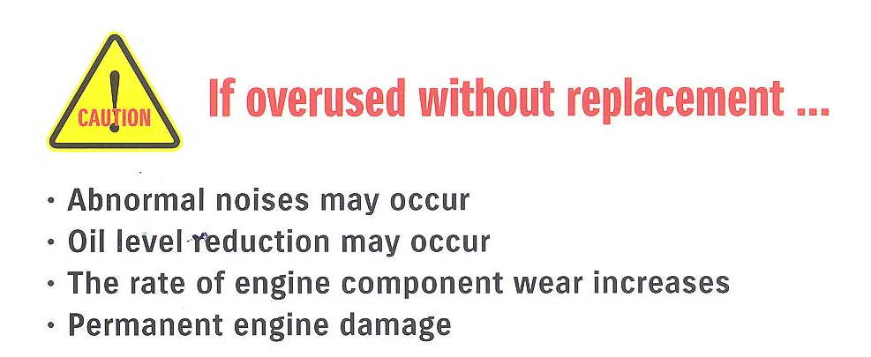
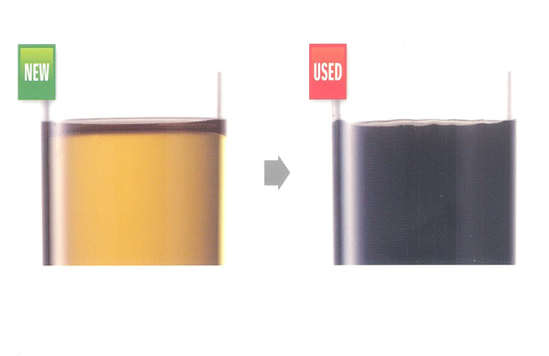
ENGINE
ENGINE OIL

Slide 70
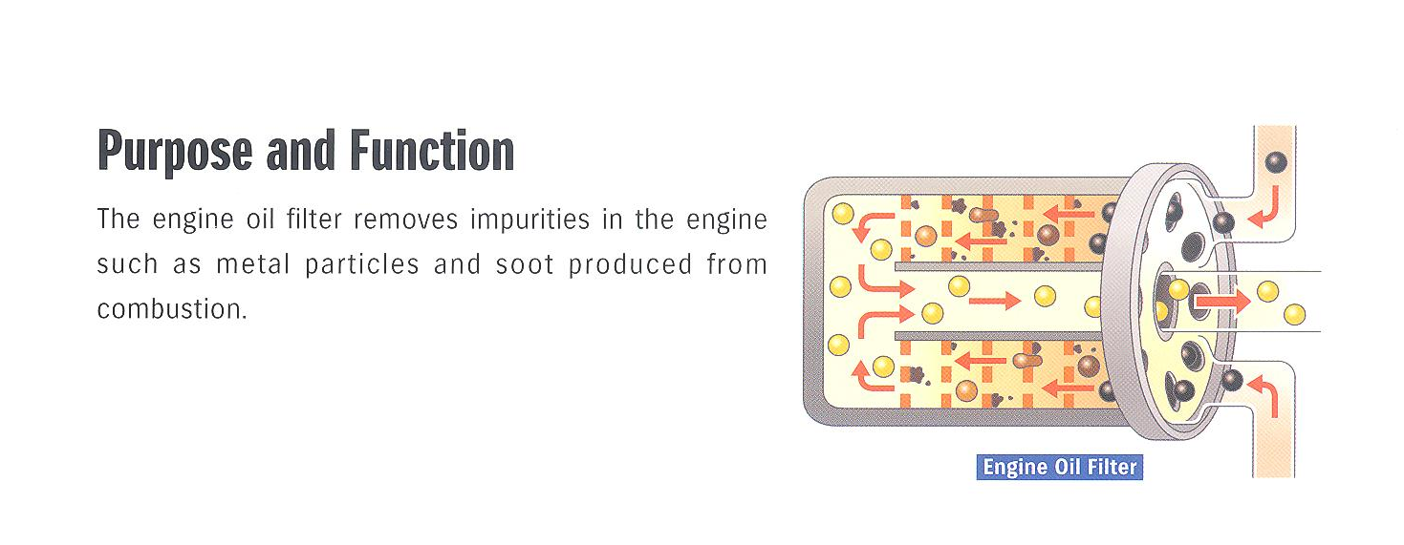
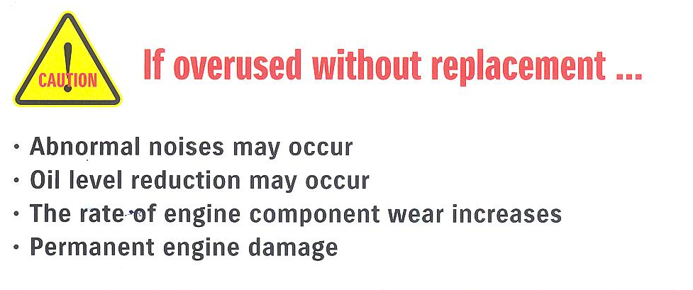
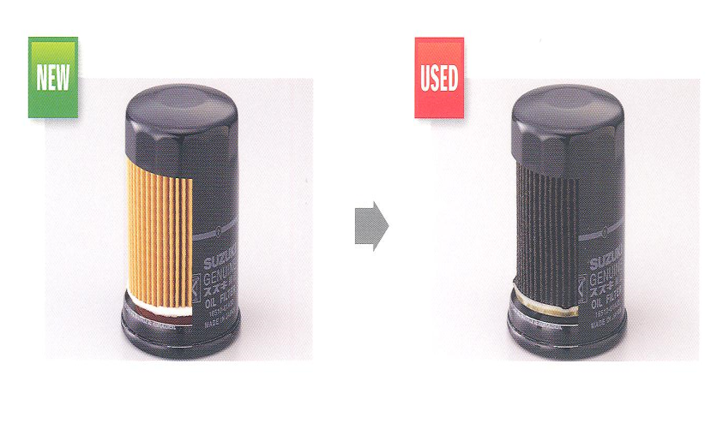
ENGINE
OIL FILTER

Slide 71
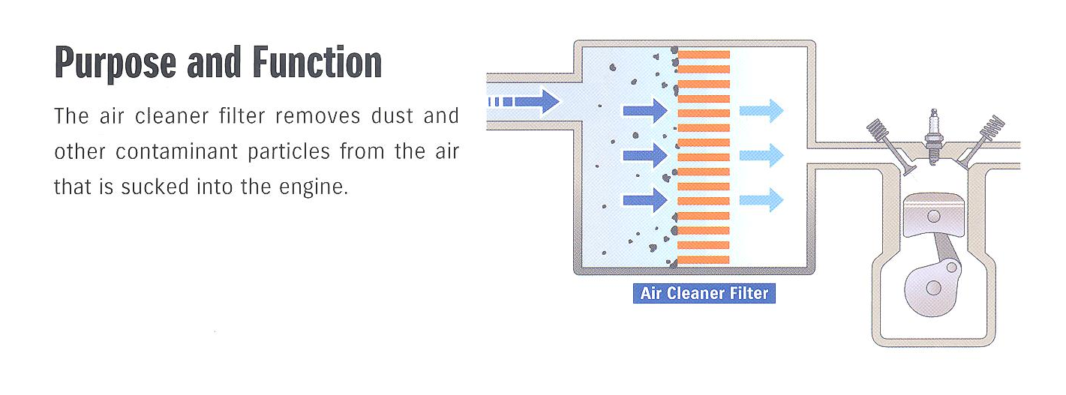
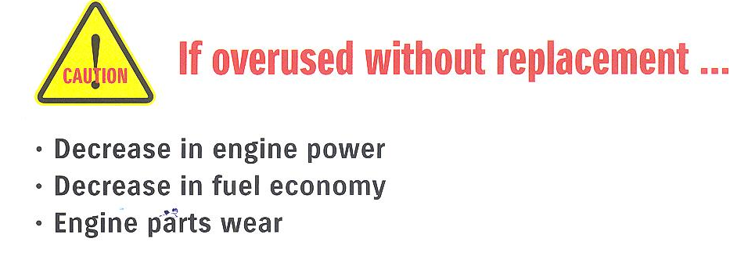
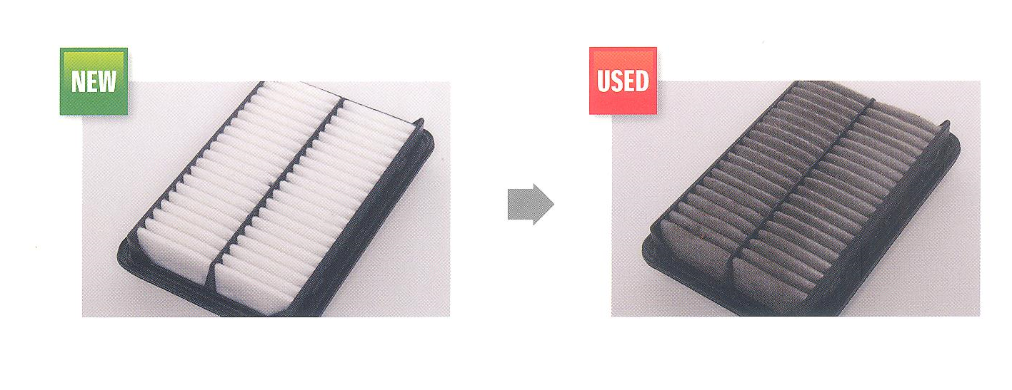
Engine
AIR FILTER

Slide 72
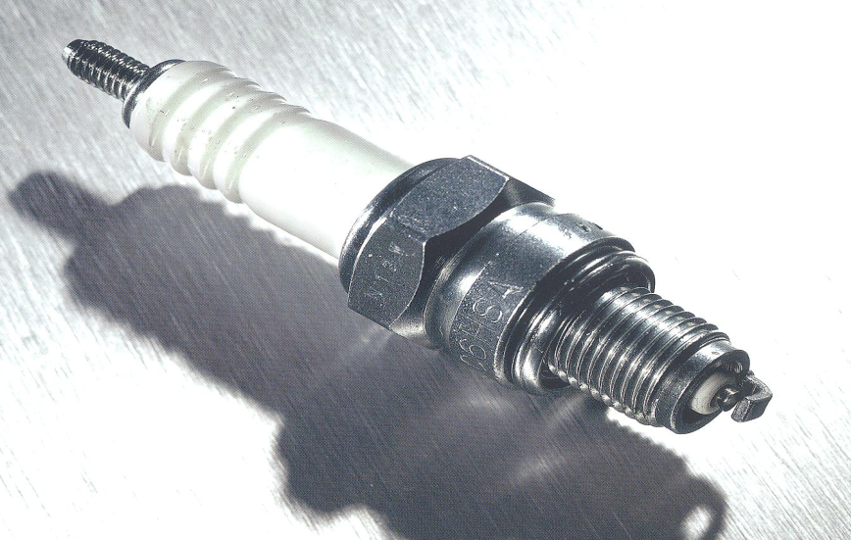
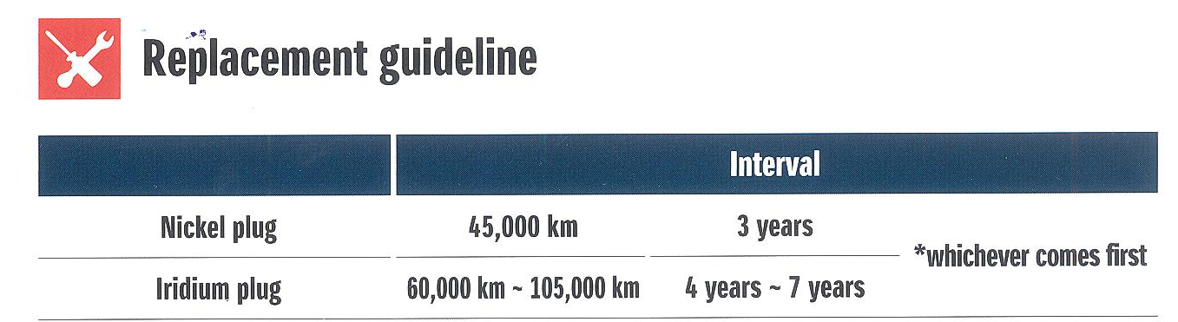
Engine
Spark Plug
Care benefits
  Maintain the quality of burning of the air fuel mixture in the combustion chamber.
Damages
  Incomplete combustion of air fuel mixture
  Poor acceleration and more fuel consumption
  Shortens engine life
  Damage to the piston

Slide 73
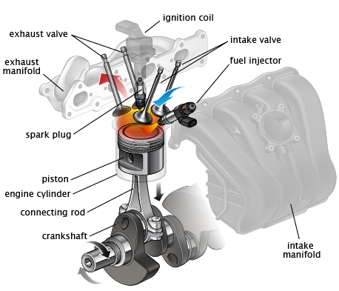
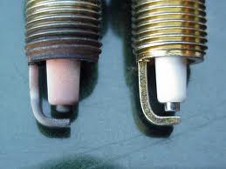
Engine
Spark Plug
OLD
NEW

Slide 74
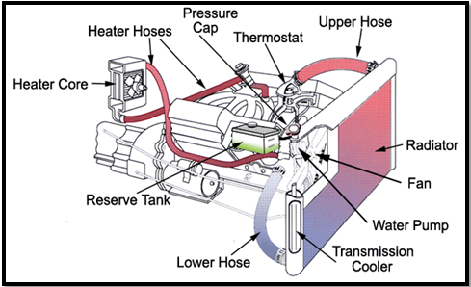
Cooling System

Slide 75
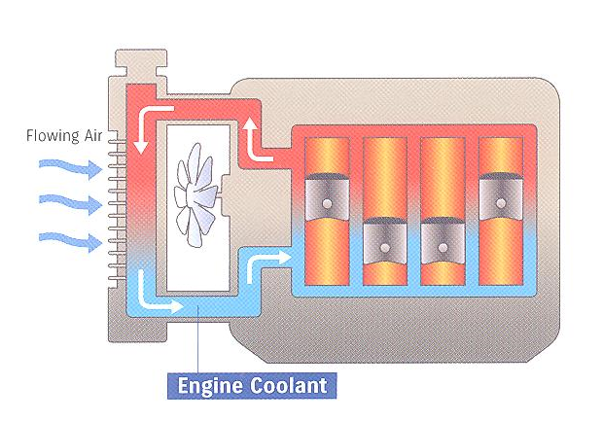
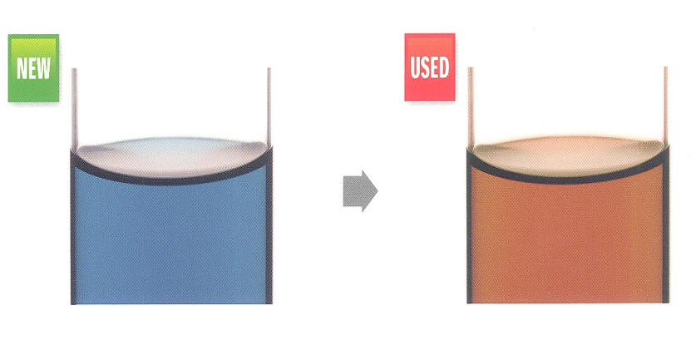
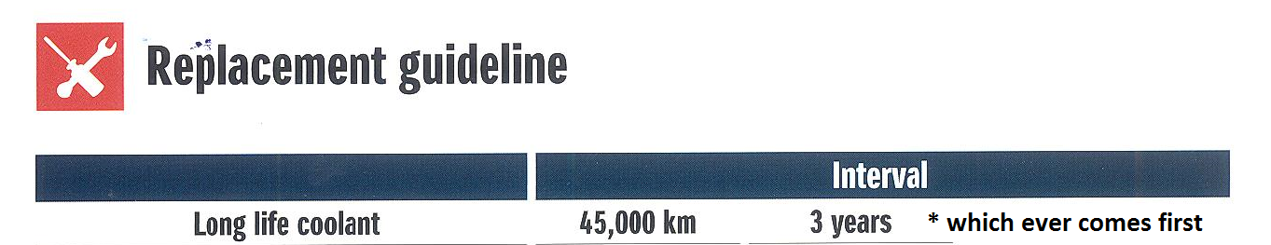
Cooling System
Care benefits
  It removes heat from engine components
  It cools the engine as soon as possible and maintain optimal engine operating temperature
Damages
  If cooling system (radiator) stops working properly, engine temperature will exceed the optimal range causing engine to stop due to over heating

Slide 76
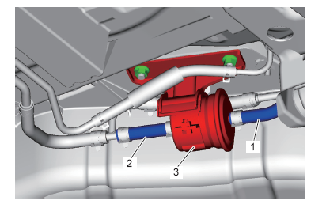
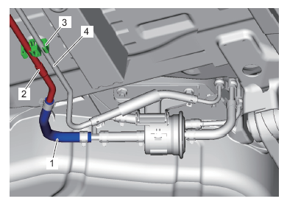
FUEL SYSTEM
FUEL PIPES INSPECTION
A fuel system is critical in storing and delivering fuel (petrol) to the engine like vascular system with a heart (fuel pump), veins (fuel lines) and kidney (fuel filter).
Inspect fuel lines, hoses, connections for any leakages.

Slide 77
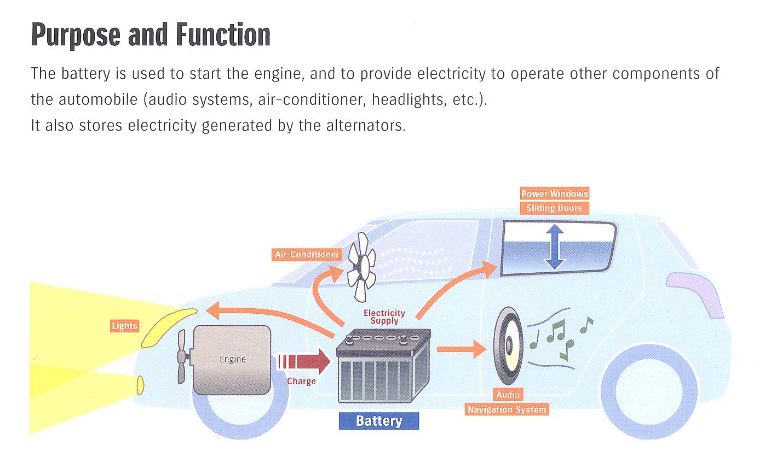
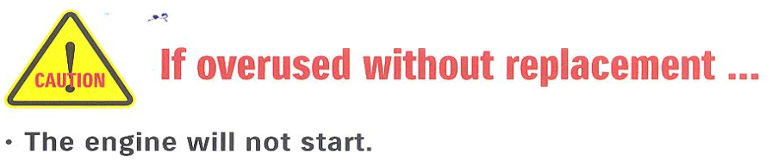
ELECTRICAL
BATTERY

Slide 78
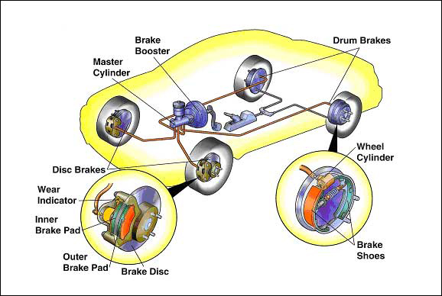

Braking System

Slide 79
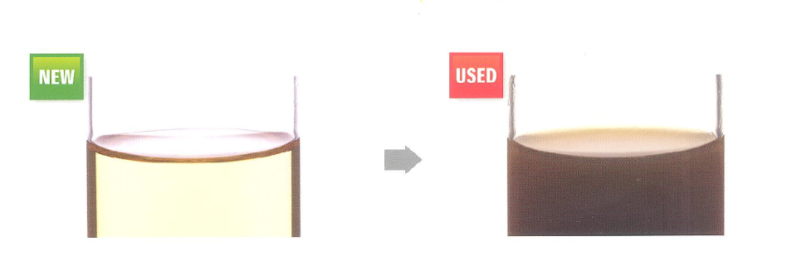
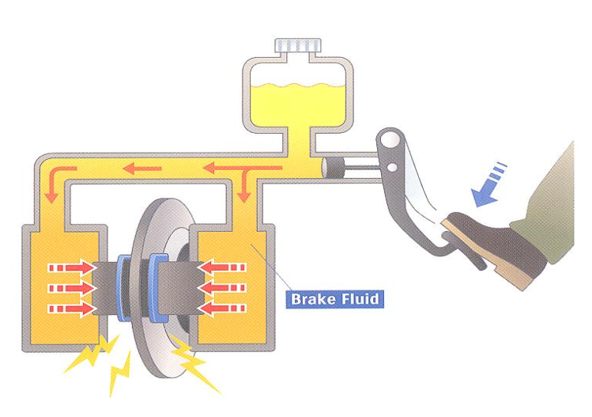
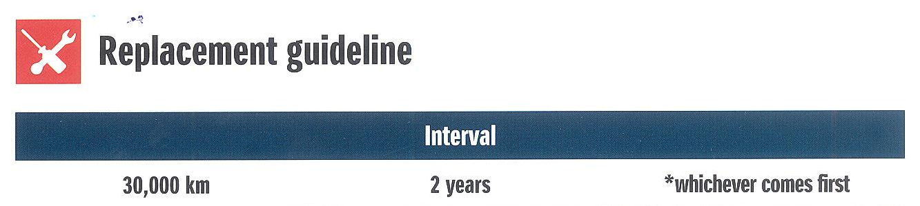
Brake Oil Replacement
Brake Oil
Care benefits
Brake oil replacement under regular interval will maintained the required pressure & force to expand the brake pads and shoes through brake caliper and cylinders pistons for effective braking.
Damages
  Low brake force will increase the vehicle stopping distance, spongy brake pedal due to excessive moisture & seizing the brake components.
Brake Oil Test

Slide 80
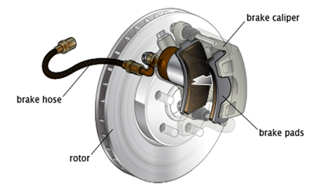
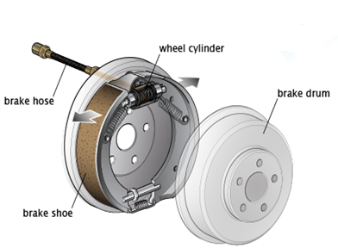
Disc & Drum Brake
Brake
  There are two types of brakes
  Disc brake
  Drum brake
Care benefits
  Well maintained brakes will provide effective and quick braking as soon as brake pedal is pressed. It will also stop fast moving vehicle in minimum time possible preventing any slippage.
Damages
  Brake pedal vibrates noticeably when stepped on
  Worn brake pads damage brake disc
  Jam brake while braking
  Distance increases between brake pad and disc

Slide 81
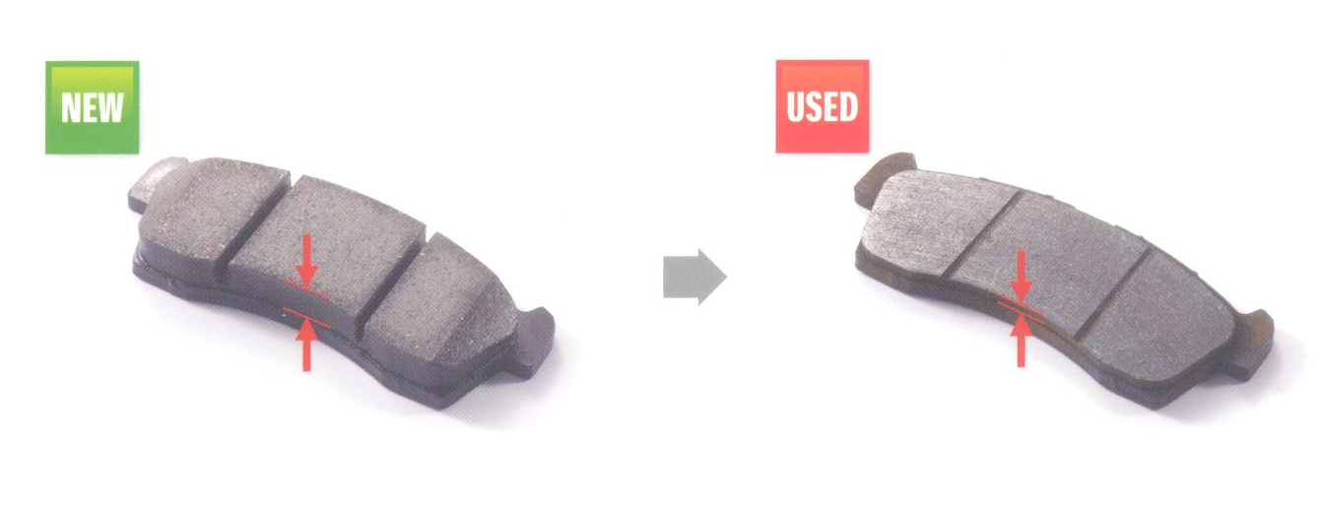
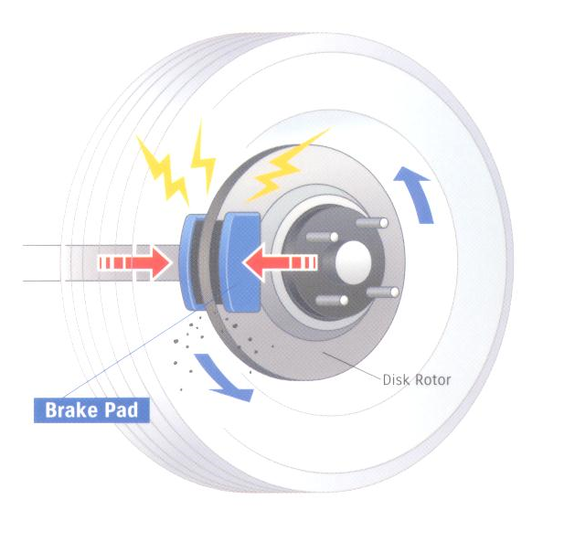
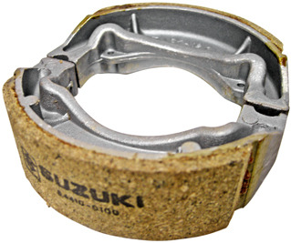
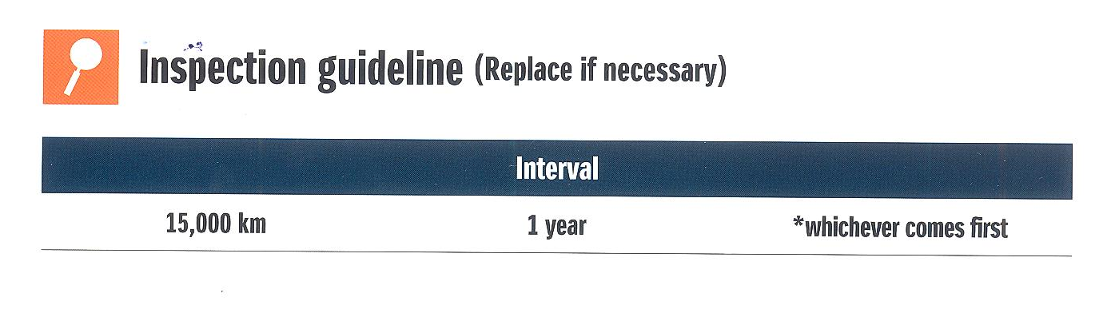
Disc & Drum Brake

Slide 82
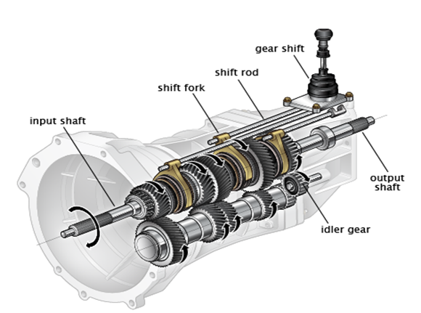
Transmission system

Slide 83
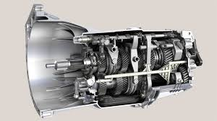
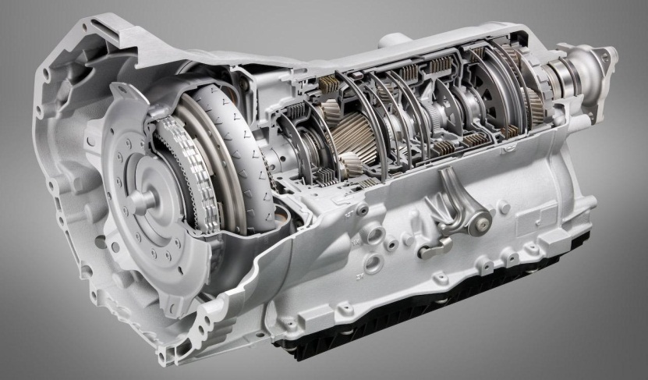
Transmission System
Transmission
Care benefits
To keep the transmission in good working condition and noise free, replace transmission fluid at given interval
  There are two types of transmissions available:
  Manual Transmission
  Automatic Transmission
Damages
  Difficult to move the gear teeth
  If the oil layer is thin, it will damage gear components due to metal to metal contact.
  There will be a rise in noise and vehicle will feel heavy when in gear
Manual Transmission
Automatic Transmission

Slide 84
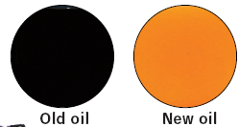

Transmission oil replacement criteria
Function: this oil lubricates and cools the parts of transmission and prevent them from burning. It also acts as a anti rust agent.
Replacement criteria: inspect every 5000km, replace every 40000km.
If replacement is not done: there will be a unusual noise and in worst case scenario there will be burning leading to damage.

Slide 85

Charging System

Slide 86
Call Handling Skills.

Slide 87
Goals
Improve comfort and confidence on the phone
Use customer-service strategies that get results
Enhance the public’s image of company by providing superior customer service over the phone
Notes:
IUE

Slide 88
Objectives
At the end of this training, you will be able to define and describe:
A Customer’s Basic Needs
5 Dimensions of Customer Service
How to Manage a Call
Projecting a Positive Image
Techniques for handling difficult phone situations
Notes:
A5HPT

Slide 89
The Basic Needs of the Customer on the Phone
To be recognized and remembered
To feel valued
To feel appreciated
To feel respected
To feel understood
To feel comfortable about a want or need
View each caller as a customer
Notes:
VARUC

Slide 90
Satisfying customers over the telephone is often more challenging than serving face-to-face.

Slide 91
5 Dimensions of Customers Service
Professionalism
Speedy Responses
Accurate Information
Genuine Concern
Reliable Follow-up
Notes:
PSAGR

Slide 92
5 Dimensions
Professionalism - use thank you and please, control background noise, don’t use office-specific jargon or acronyms
Speedy Responses - predict follow-up time, don’t lengthen conversation with idle chatter, don’t take more than 24 hours to return a call, time is money

Slide 93
5 Dimensions (Con’t)
Accurate Information - use easy-to understand examples, don’t blame others, don’t use outdated material
Genuine Concern - use empathy, don’t judge caller’s feelings, don’t let one negative call “bleed” into another
Reliable Follow-up - responsibility to carry out promised action

Slide 94
Positive Attitude
The Engine that drives
excellent service
forward.
.
The key ingredient in providing the
5 Dimensions of Customer Service.
Notes:
ENGINE+KEY

Slide 95
Advantages of a Positive Attitude
Creates goodwill with caller
Reduces the potential for irritating the caller
Lessens stress for you
Helps you enjoy your job more
Creates a more productive work environment
Notes:
CRLHC

Slide 96
Applying Positive Attitude to Create Positive Impressions
Word choices seem simple, but small changes make a dramatic difference
Positive phrasing creates an environment where caller can respond with an open mind
“Please, Hold on a minute” – positive
“ How can I help you Sir – positive
Notes:
WP

Slide 97
Managing the Call
Answer Promptly (within 3 rings)
Greet the Caller and Identify Yourself
Offer to Help
Listen Carefully
Use Caller’s name
Notes:
AGOLU

Slide 98
Example
“Thank you for calling Suzuki ABC Motors, this is Florence, how may I assist you today?”
“Yes, Mr. Dev, I will check on the status of your complaint. Would you like to hold or would you prefer I call you back in a few minutes with an answer”)

Slide 99
Managing the Call
Avoid blind transfers
  Ask the caller whether he or she can hold
  Tell caller to whom they’re being transferred
  Briefly introduce the caller to the coworker
Closing the Call
  Close Call Formally
  Repeat action you agreed to take
  Say “Good-bye” instead of “Bye-bye”

Slide 100
Angry Callers
Recognizing the Signs of an Angry Caller:
  High-pitch speech
  Long pauses
  Sighs
  Demands
  Short-terse answers
  Volume gets louder
Notes:
HLSSDV

Slide 101
2 Problems of the Angry Caller
A relationship problem with the Company
  Company’s relationship with the customer is broken
  Usually because basic needs aren’t being met
Specific problem that needs attention
Notes:
RS

Slide 102
7 Steps for Resolving the Angry Customer’s Problem
Deal with feelings first. Listen and respond with empathy.
Ask questions to get specifics about the complaint
Summarize caller’s problem to get agreement
Offer a choice of alternatives to fix the problem
Let the customer decide which alternative to use
Follow through on what you agree to do
When possible, do something extra.
Notes:
DASOL FW

Slide 103
Abusive Caller
Definition:
A caller who goes beyond expressing anger about a problem and begins attacking the person handling the call
Often includes swearing and personal attacks

Slide 104
Handling Abusive Callers
Abusive Callers:
Stay Calm
You’re not the target
Give caller warning
  “I beg your pardon?”
  “I don’t appreciate the language you are using.”
  “If you aren’t able to talk with me without swearing, I will have to end this call.”
If the call terminates, inform supervisor immediately
Notes:
SYGI

Slide 105

THANK YOU FOR YOUR ATTENTION

